Slide 1
Fraud Detection
In Financial Transactions
Group 2

Slide 2






Our Team
Avishek Dasgupta
Santosh Pawan Kurada
Shivam
Mishra
Siddhant
Treasure
Soham
Agarwal
Varun
Annapareddy

Slide 3
As reported by the FTC in 2022
400,000
Reports of credit card frauds
In the United States, financial fraud has become a significant concern with substantial monetary losses reported annually. According to the Federal Trade Commission (FTC), consumers reported losing nearly $8.8 billion to fraud in 2022
1.1 million
Reports of identity theft
315,000
Reports of phishing attacks

Slide 4

Our Client
However, the digital era has introduced sophisticated financial frauds, posing significant risks to customer trust and the institution's stability. The urgency to combat these threats has become paramount, necessitating innovative and robust security measures.
In response, our client has embarked on a strategic initiative to develop a state-of-the-art, SQL-based real-time fraud detection system. This project is aimed at harnessing the power of real-time data analytics, to identify and neutralize fraudulent activities efficiently.
Our client, a prominent figure in the financial landscape, renowned for its extensive banking services and comprehensive credit card operations, serves a diverse customer base and maintains a wide network of merchant partnerships.

Slide 5
Financial Data
Customer Profiles
Transaction Data
Leveraging detailed customer profiles to personalize fraud detection measures and enhance security
Utilizing comprehensive transaction metadata, records, and anomaly scores, alongside merchant and fraud indicators, to dynamically identify and adapt to new fraudulent patterns in real-time.
Accounts
Merchant Information
Analyzing customer account activities to detect irregular patterns and secure account integrity
Examining merchant information to identify potential risks and ensure transaction authenticity.

Slide 6
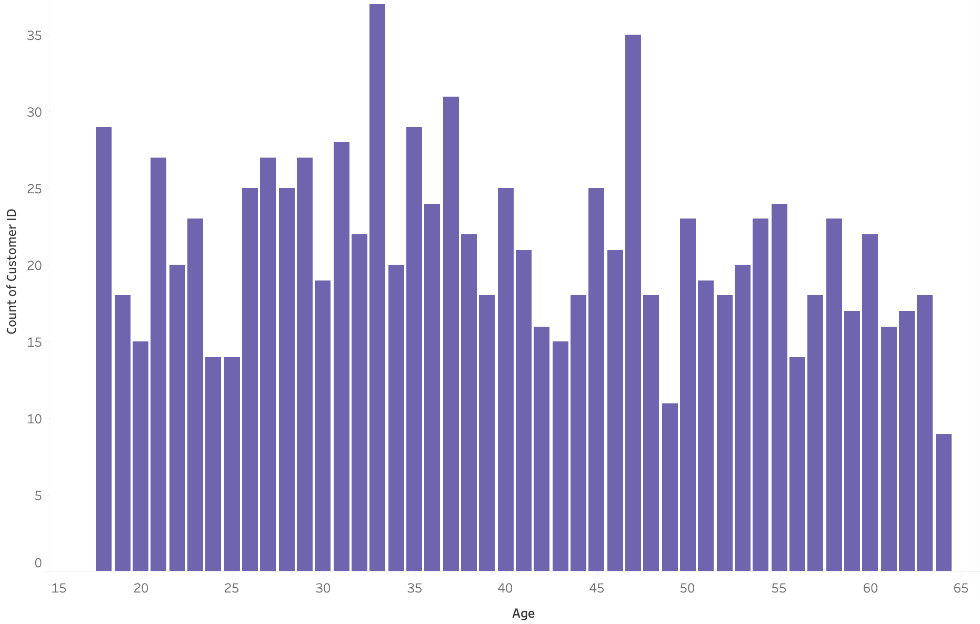
651
1000
5
Total Merchants
Total Transactions
Category Transactions
Data Summary

Slide 7
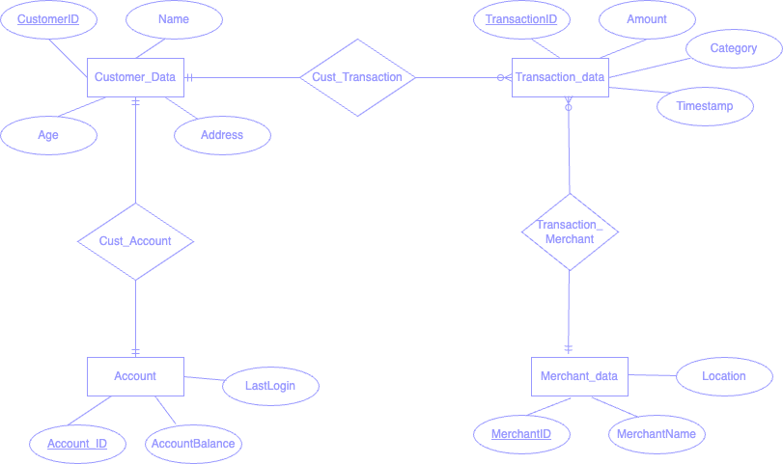
Entity
Relationship
Diagram

Slide 8
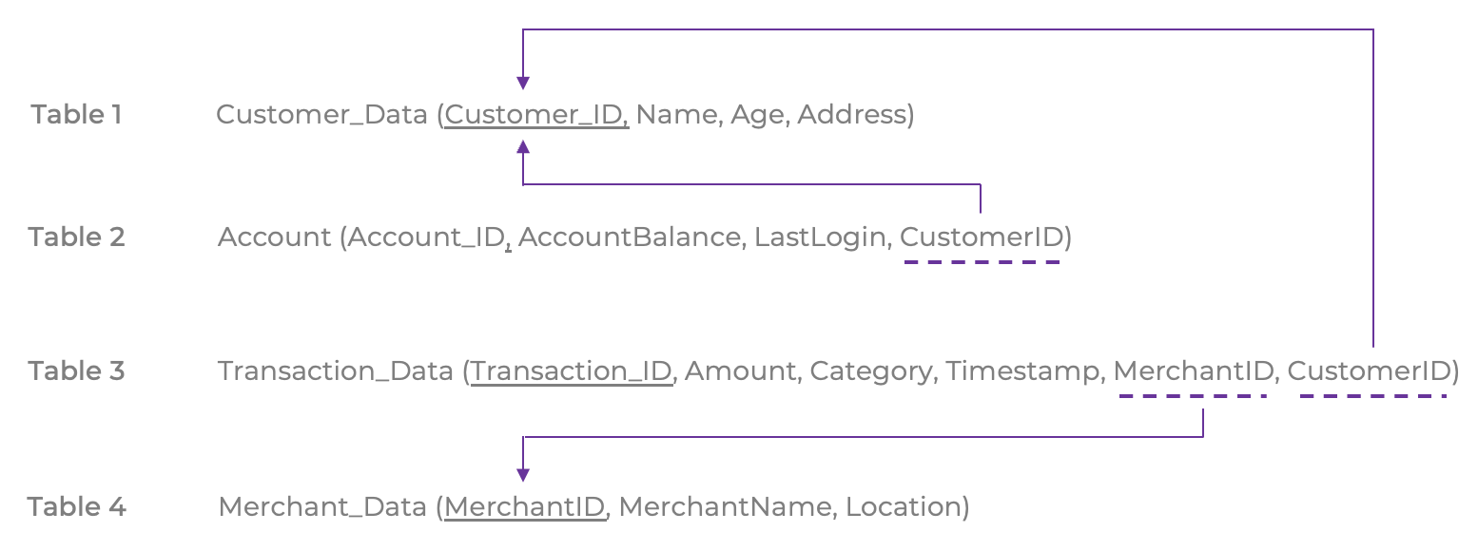
Relational Schema

Slide 9
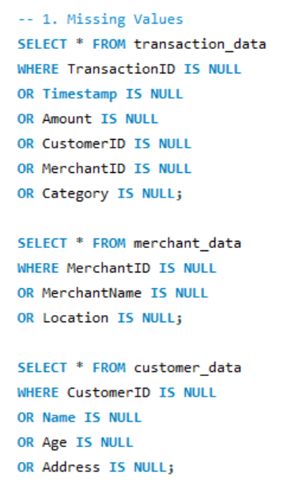
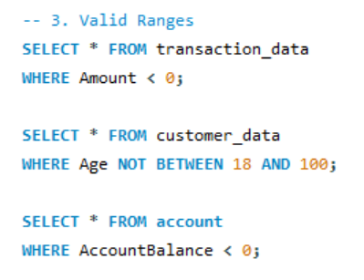
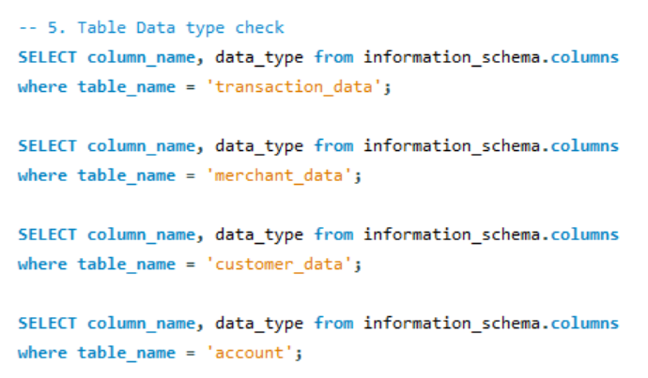
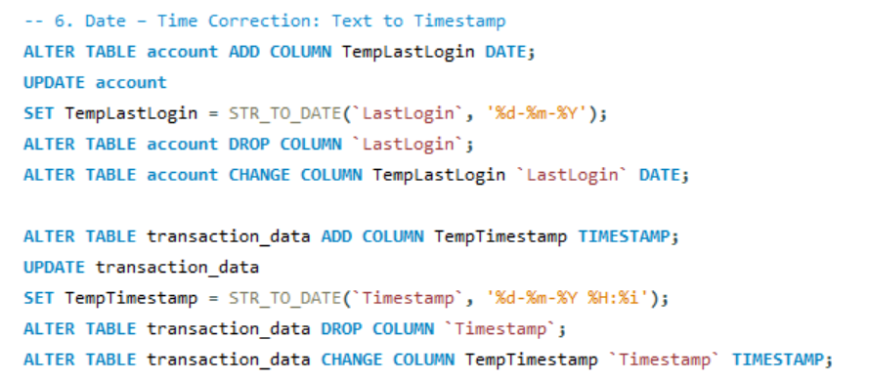
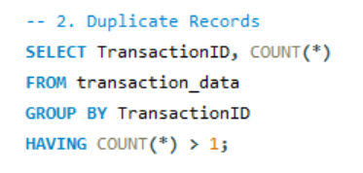
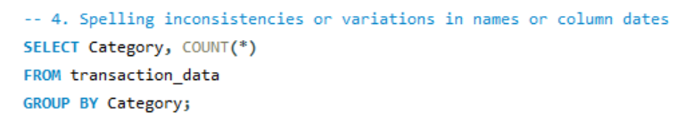
Data Cleaning using SQL
1
3
5
Missing Values
Valid Ranges
Table Datatype Check
Duplicate Records
Inconsistencies
Date and time correction
2
4
6

Slide 10
Key Focus Areas
Transaction Data
Accounts
2
4
1
3
Merchant Information
Customer Profiles

Slide 11
Anomaly Score Calculation
Repeated Transactions
Account Inactivity
25%
15%
Uncommon Merchant-Category Combinations
Time Score
20%
3%
30%
7%
Amount Score
Account Transaction Volume

Slide 12
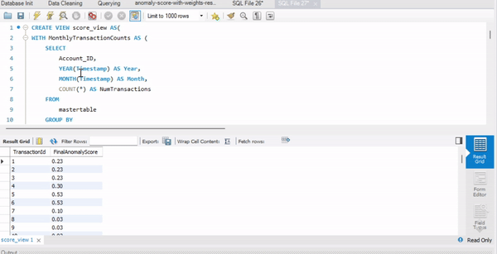







Query Structure
This SQL query performs anomaly detection on financial transactions by calculating scores based on various risk factors. It uses a series of Common Table Expressions (CTEs) to break down the process
Top5PercentThresholds Determines the threshold for top 5% in terms of transaction volume for each month.
RankedTransactions
Ranks account by their transaction volume within each month.
MonthlyTransactionCounts Aggregates transactions by account and month, counting transactions for each account
TotalAccountsPerMonth
Counts the total active accounts per month.
AnomalyScores
Calculates preliminary anomaly scores based on transaction amount, transaction timing, account inactivity, and uncommon merchant-category combinations.
FinalScores
Combines the preliminary scores with additional weight for accounts in the top 5% of transaction volume to produce a final anomaly score for each transaction
Top5PercentAccountsPerMonth
Identifies accounts in the top 5% of transaction volume.
SimplifiedCategories
Simplifies transaction categories into broader groups for analysis.

Slide 13
Query Structure
This SQL query performs anomaly detection on financial transactions by calculating scores based on various risk factors. It uses a series of Common Table Expressions (CTEs) to break down the process
Top5PercentThresholds Determines the threshold for top 5% in terms of transaction volume for each month.
RankedTransactions
Ranks account by their transaction volume within each month.
AnomalyScores
Calculates preliminary anomaly scores based on transaction amount, transaction timing, account inactivity, and uncommon merchant-category combinations.
FinalScores
Combines the preliminary scores with additional weight for accounts in the top 5% of transaction volume to produce a final anomaly score for each transaction

Slide 14
Scoring Metrics
Score
How it works
RepeatedTransactionScore
Counts identical transactions (in amount and other factors) within a certain period for the same account. Higher counts indicate higher likelihood of anomaly.
AmountScore
Transactions exceeding a certain value threshold (e.g., 75th percentile) receive a higher score, indicating potential risk.
InactivityScore
Based on the time difference between the transaction date and the last active date (e.g., last login). Longer periods of inactivity result in higher scores.
TimeScore
Transactions in predefined "unusual" hours (e.g., late night) are given a higher score. "Unusual" hours can vary by customer behavior and timezone.
UncommonMerchantCategoryScore
Analyzes the frequency of merchant-category combinations. Rare combinations (e.g., bottom 5% by frequency) are assigned higher scores.

Slide 15
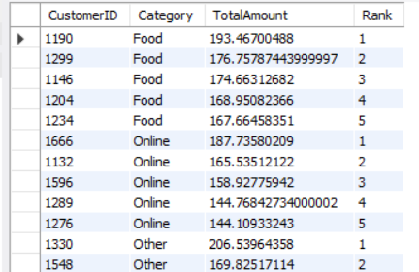
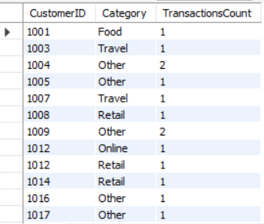
Transaction Data
A query to identify the top 5 customers by total transaction amount within each category, including their rank based on the transaction amount.
Utilizes: Aggregate functions, Common Table Expressions (CTEs), Window Functions
Business Impact: The output ranks the top 5 spending customers in each category, providing insights into customer spending patterns and identifying key revenue segments for targeted marketing initiatives and strategic business planning
This query aims to identify each customer's most frequent transaction category, utilizing a combination of joins, string functions, and window functions to rank categories by frequency.
Utilizes: Joins, string functions, window functions, aggregate functions
Business Impact: To determine which categories are most popular among individual customers, supporting personalized marketing efforts and inventory management providing a clear picture of spending habits for targeted engagement and service improvement

Slide 16
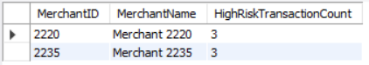
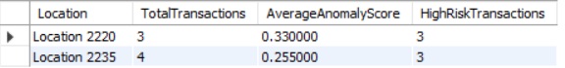
Merchant Information
Check for merchants with an unusually high number of high-risk transactions.
Utilizes: Subqueries, Aggregate Functions, Joins
Business Impact: The query flags merchants with transaction counts well above the high-risk category average, indicating potential involvement in fraud. This aids proactive risk management and merchant auditing.
Analyze transactions based on the merchant's location to identify regions with a higher occurrence of high-anomaly-score transactions, which could indicate regions more susceptible to fraudulent activities.
Utilizes: Joins, Conditional Aggregation, Case Statements
Business Impact: The query detects fraud patterns by location, identifying areas with a high prevalence of risky transactions. This is crucial for regional fraud monitoring and preemptive security measures, pinpointing hotspots for scrutiny and guiding regional fraud prevention strategies.

Slide 17
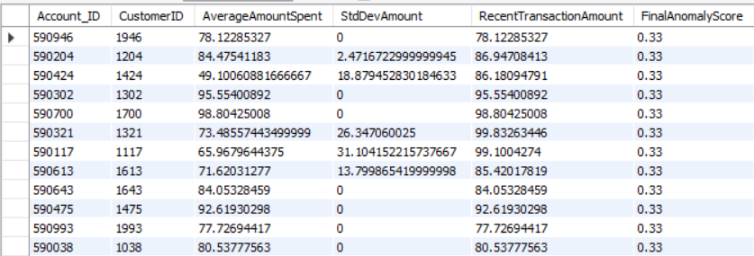
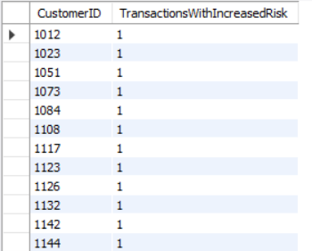
Accounts
This query aims to detect accounts with irregular patterns by looking for anomalies in transaction amounts compared to the usual account activity.
Utilizes: Window Functions, Aggregate Functions, Joins
Business Impact: The query identifies accounts with recent transactions deviating significantly from the norm, indicating potential fraud with high anomaly scores. This aids in early detection, ensuring account security and trust. Results pinpoint accounts needing further investigation or monitoring for irregular activity.
This query detects customers whose transaction risk scores have significantly changed recently, indicating potential account compromise or change in spending behavior.
Utilizes: Window Functions, Conditional Aggregation
Business Impact: The query detects customers with rising risk scores, indicating potential unusual activity and prompting further investigation to prevent fraud and protect account integrity. Results highlight notable increases in risk scores, potentially signaling fraudulent behavior or shifts in financial habits.

Slide 18
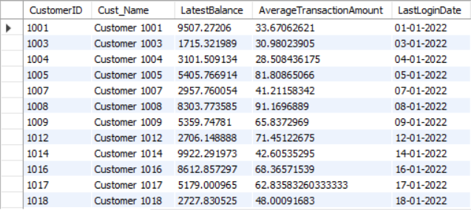
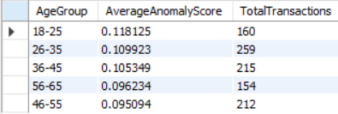
Customer Profiles
When you execute this query, you're asking the database to provide you with a financial profile for each customer based on the data stored across different tables.
Utilizes: SQL Modes, Views, Window Functions, Aggregate Functions, DISTINCT Clause
Business Impact: This view displays each customer's latest balance, average transaction amount, and recent login date, crucial for detecting high transaction activity or potential irregularities. It facilitates proactive customer engagement and account management.
This query calculates the average anomaly score across different age groups, helping to identify if certain age demographics are more associated with transactions that have high anomaly scores.
Utilizes: Case statements, Aggregate Functions, Joins
Business Impact: The query categorizes customers by age to analyze transaction anomaly scores for fraud risk patterns. It identifies age groups with higher-than-average anomaly scores, guiding tailored risk management and customer education.

Slide 19
Conclusion
Anomaly Indexing
Merchant Analysis
Geographical Trends
Customer Profiling
Demographic Insights
Dynamic Scoring

Slide 20
Thank You
“Going to steal your money and your life.”
- Soham

